Slide 1


Slide 2

PATIENT WARD AUTOMATION
MAJOR PROJECT – 2
Under the guidance of
Dr. Varun Sapra
Assistant Professor, Department of Career Services
SoCS, UPES
Submitted By
NAME | SAP ID | ROLL NO
Swati Chaturvedi | 500067613 | R164218078
Shubh Gaur | 500069538 | R164218071
Shivansh Gupta | 500069013 | R164218065
Jay Mittal | 500069171 | R164218033

Slide 3



INTRODUCTION
During a pandemic, there is a need for a quick and responsive automation system that can help doctors and nurses minimize their workload, therefore a patient automation system could be an effective solution.
This system will be a user-friendly application. The hardware used is a combination of Raspberry Pi, a Relay Module, a light bulb, various sensors like oximeter & pulse meter to record patient data & allow patient to alert doctor or nurse in case of any requirement or emergency.
This system can act as a bridge between doctors and patients. Patients will benefit from early medication reminders and the convenience of bed automation and room automation, etc. In the case of an emergency, the IoT system will notify the staff & assists our doctors.

Slide 4
PROJECT FEATURES
Automation is revolutionizing many industries, including healthcare. Automation helps improve patient outcomes by supporting technological advancements, making processes more efficient and effective.
It is re-imagining healthcare by enabling efficiencies that would be impossible with manual processes. As a result of freeing staff from less human-facing work, patients receive better care.
One of the effective smart automation technologies can be smart ward automation solution enable medical care staff to more accurately plan nursing services, coordinate clinical services, and create a warm environment through timely, reliable application.
Will help to Achieve intelligence, refinement & emotionalization of ward management.
The workload of nursing staff is reduced with the help of the one-click help and emergency contact function is integrated.
Light/air conditioning and other electrical systems that can be controlled by the patient via wireless or bedside touch panel.

Slide 5
PROBLEM STATEMENT
Manually managing is a very tough and time-consuming process & requires more workload.
Sometimes, it is not feasible for the patient and the staff/doctor to stay connected throughout.
There are so many basic needs of a patient that should be taken care but due to limited staff in critical situations like ongoing pandemic, it's nearly impossible for them to manage large number of patients with equal assistance.

Slide 6
OBJECTIVE
Our goal is to build a smart hospital ward automation system based on Internet of Things (IoT) technology.
Create a system that can automate wards to a certain extent and help infrequent health monitoring and observation of patients in hospital wards, resulting in early diagnosis and treatment.

Slide 7
LITERATURE REVIEW
D. M. H. T. Dasanayake, P. S. Gunasekara, H. D. Wickramasinghe, S. Fernando and A. L. researched about a novel intelligent Automated Hospital Ward Management System (AHWMS) based on a mobile robotic platform named WDBOT for a hospital ward. The aim research is to provide an automated mobile robot based solution to improve the effectiveness of ward management and medicine management and distribution processes. AHWMS interacts with WDBOT via wireless network to achieve the abovementioned tasks with the help of controlling, image analysis, processing and communication. Verification of the system was done with the help of simulation and physical modelling of some units.
Dharm SinghJat, Anton S.Limboa,CharuSingh presents a speech-based automation system to assist patients in an orthopedic ward to automate processes using voice commands. The system is beneficial to patients who have little ability to move around as it enables them to automate processes using voice commands, hence reducing reliance on nursing staff and caregivers.

Slide 8
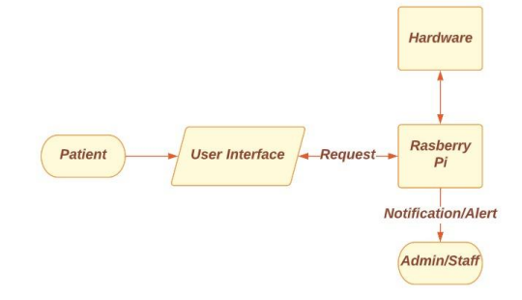
APPLICATION WORKFLOW

Slide 9
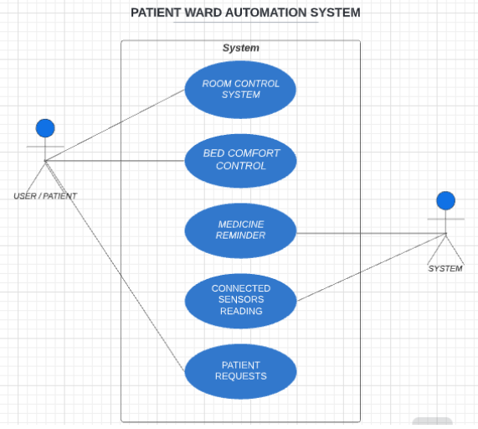
USE CASE DIAGRAM

Slide 10
ARCHITECTURE
The patient is using the proposed user interface to get access to all the given facilities which is there to automate the ward.
In the next step Raspberry Pi/Hardware will receive the request from the patient in the form of a Notification/Alert which will then get forwarded to the staff so that the patient request will be taken care of without failure.

Slide 11
TECHNOLOGIES USED
Software Required | System Required | Libraries
Operating System: Window or Mac, Raspbian OS Technology: Python, Micro-python | Raspberry pie 3 B+ Minimum Sensor Requirements: • MLX90614 • Servo motors • Relay module | Tkinter SQLite3 Datetime Threads PIL smtplib

Slide 12
SWOT ANALYSIS
STRENGTH
Reduces manual workload with the help of automation
Faster response
User-Friendly Interface
Regular get in touch with Doctor/staff
Convenient Patient monitoring
THREATS
Privacy of patient data/information can be exploited
Delay in Notification can cause harm to the patient’s health
WEAKNESS
Over congestion of notification
Traffic can cause the delay
Installation cost is high
Internet connectivity is must
OPPORTUNITIES
Looking towards the common scenarios nowadays, automation is must.
Enable HealthTech revolution
IOT helps provide advanced healthcare facilities to patients, doctors, and researchers.

Slide 13
AREA OF APPLICATION
Hospital Ward
It will help to show all patients vital sign observations, Patient can also alert the ward manager in case of emergency or any other requirement.
It helps hospital authorities for developing comprehensive healthcare policies to enhance overall healthcare facilities like drug usage monitoring systems etc.
It will allow patients to control things on their own making things easier for patients.

Slide 14
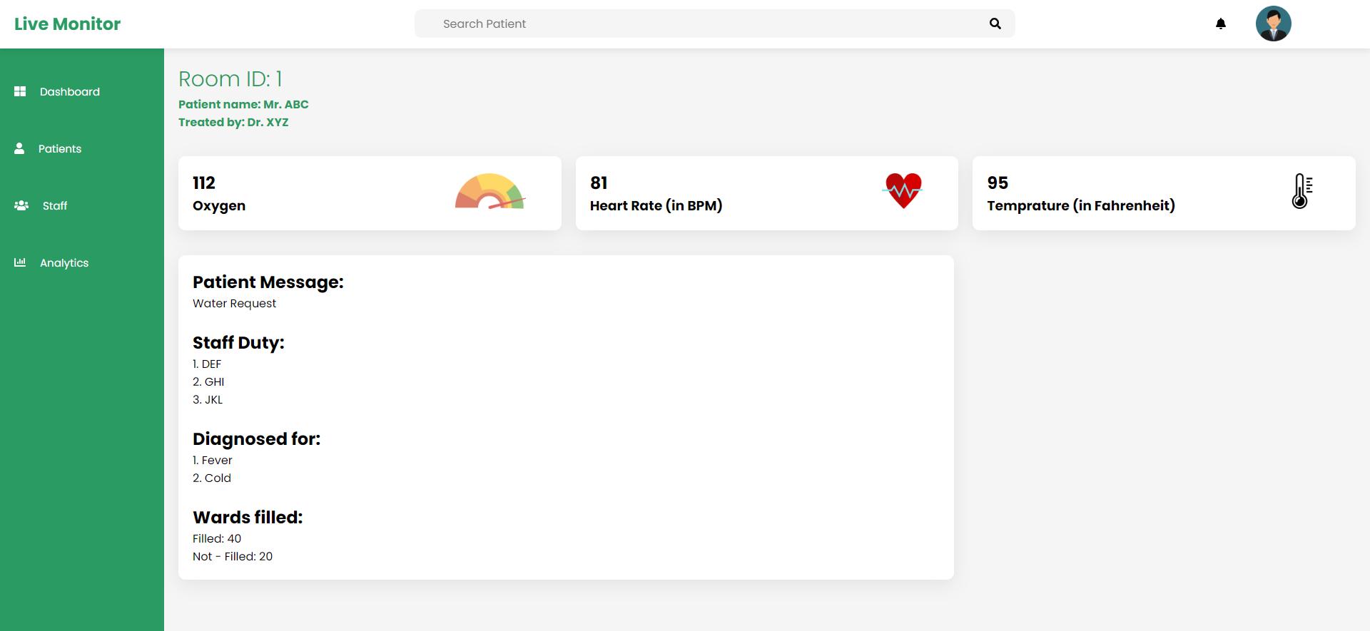
OUTPUT

Slide 15
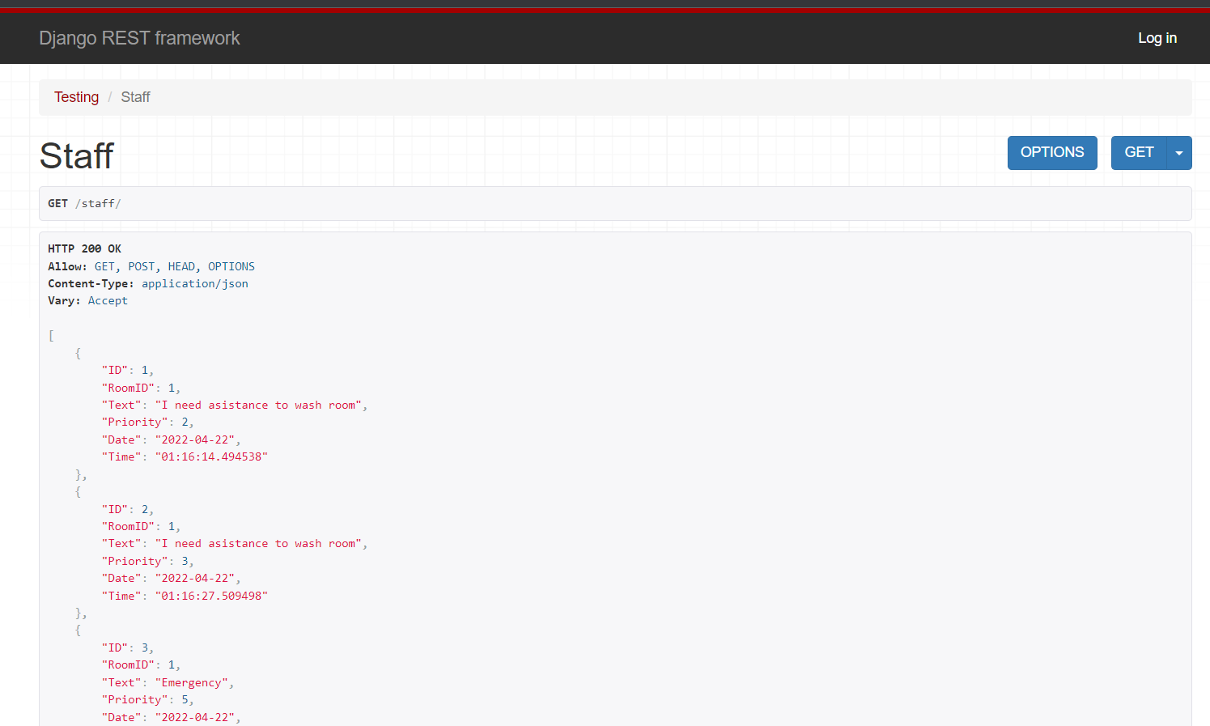
OUTPUTS

Slide 16
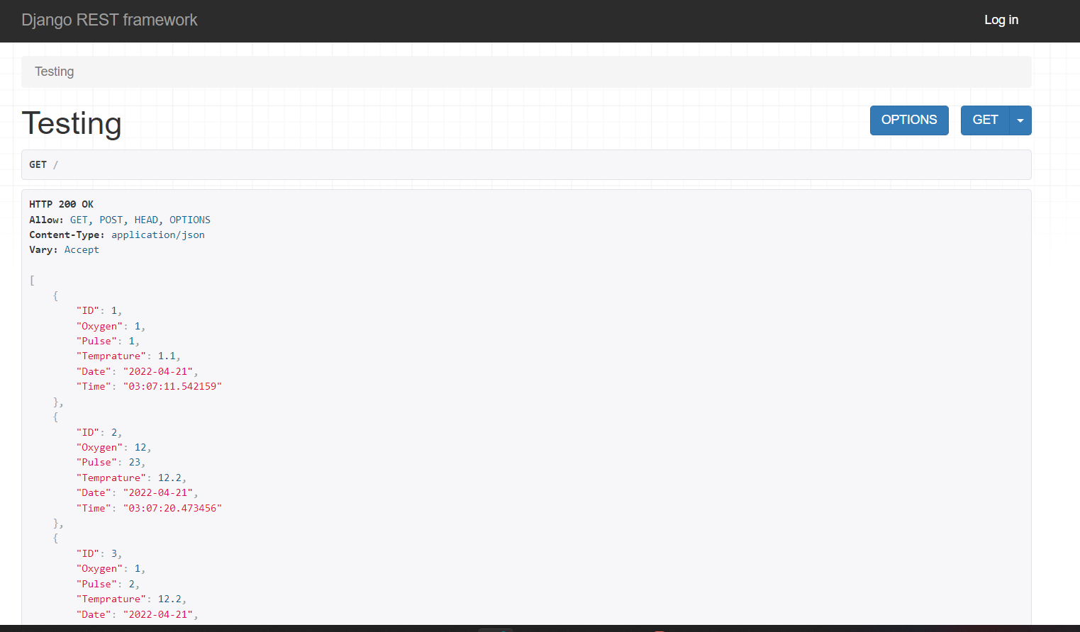
OUTPUTS

Slide 17
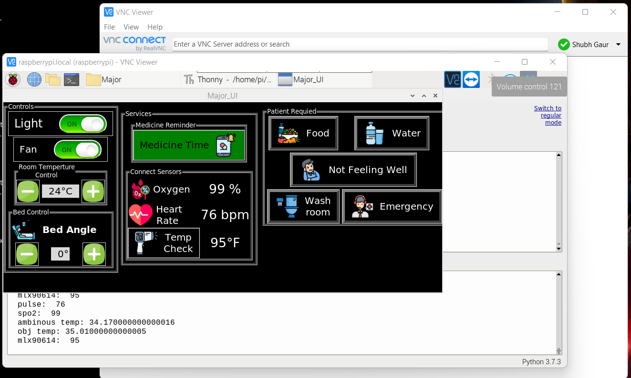
OUTPUTS

Slide 18
REFERENCES
D. M. H. T. Dasanayake, P. S. Gunasekara, H. D. Wickramasinghe, S. Fernando and A. L. Kulasekera, "Automated Hospital Ward Management System Interacting with Mobile Robot Platform WDBOT," 2018 IEEE International Conference on Mechatronics and Automation (ICMA), 2018, pp. 557-562, doi: 10.1109/ICMA.2018.8484356.
Green, C.F., Hughes, D., & Baird, R. (2009). Ward automation: an opportunity to improve the management of medicines. The Pharmaceutical Journal, 283, 395-398.
Dharm Singh Jat, Anton S. Limbo, Charu Singh, Chapter 11 - Speech-based automation system for the patient in orthopedic trauma ward, In Advances in ubiquitous sensing applications for healthcare,Smart Biosensors in Medical Care, Academic Press, 2020, Pages 201-214, ISSN 25891014, ISBN 9780128207819,
Subbe, C.P., Duller, B. & Bellomo, R. Effect of an automated notification system for deteriorating ward patients on clinical outcomes. Crit Care 21, 52 (2017). https://doi.org/10.1186/s13054-017-1635-z
Silber JH, Williams SV, Krakauer H, Schwartz JS. Hospital and patient characteristics associated with death after surgery: a study of adverse occurrence and failure to rescue. Med Care. 1992;30(7):615–29.

